Slide 1

Intro: Welcome to the Heart Basement
You are about to play a game in which you will think about practical ways to get the water out of your flooded basement, throughout the game, we will pause and make some changes to the terminology (to medical/pharmacological/physiological terms) and by analogy demonstrate how these principles that you are already familiar with apply to the treatment of heart failure. So, lets begin:
The idea of using the bucket to toss water out the window is the baseline situation. You may consider this to be the patient before any treatments. Think of the bucket as the kidney (without any treatment). While getting rid of water, the kidney is overwhelmed (and also in the body the kidney may retain water to some extent thinking it is helping the heart by providing more fluid to pump since the kidney is not seeing an adequate flow of blood when the heart fails. This lack of blood flow is a demonstration of the failing heart, not a lack of fluid. Fluid builds up, the patient gets edema or swelling (gravity dependent) and may also experience shortness of breath (at night when lying down due to redistribution of fluid) and will experience weight gain.
In the next slide, we will focus on the heart.
Notes:
Welcome to Heart Basement!
The Bucket is your heart, T

Slide 2
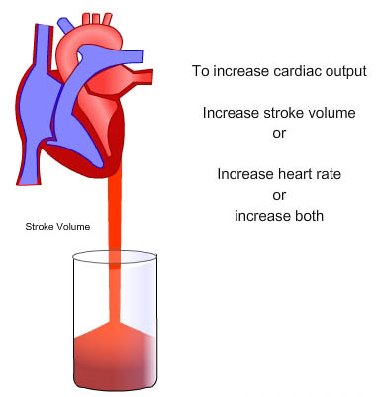
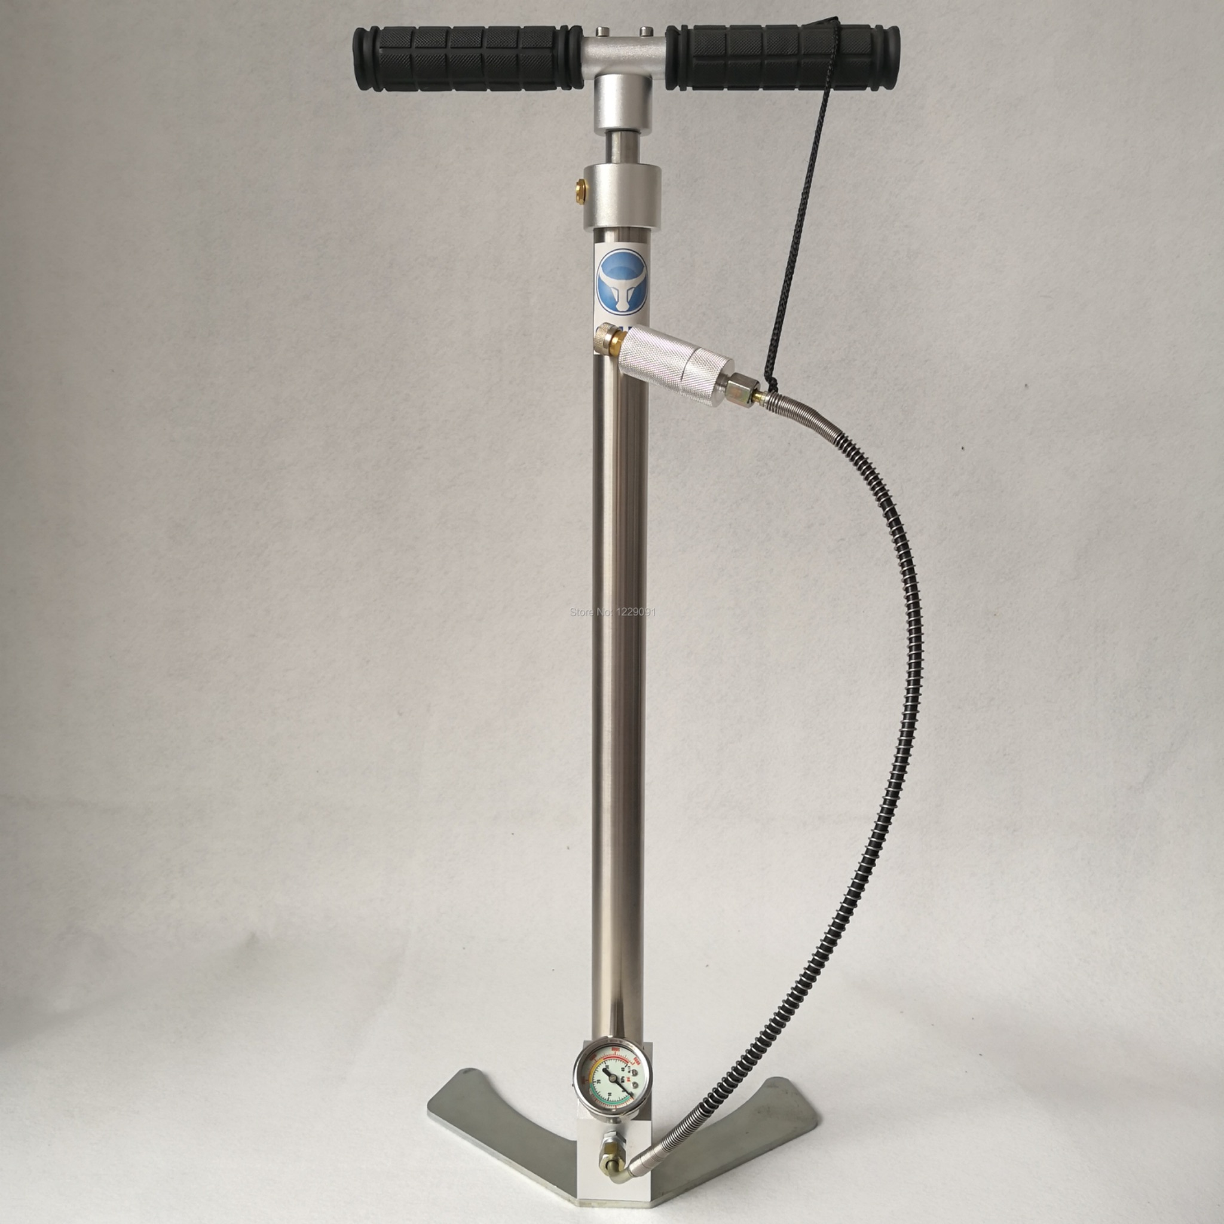
Chapt 1: Get Pump (Heart) from Hardware Store
“The Pump” you get from the Hardware Store (or in our medical analogy, the medical supply store, drug store, etc) is analogous to the Heart. Realize the heart is a pump. It is designed to pump blood/oxygen to meet the metabolic demands of the body. Now, let us consider the definition of Heart Failure - Heart Failure is the inability of the heart to provide (pump) enough blood to meet the needs of the body. The objective measure of how well the is working is the CARDIAC OUTPUT. The Cardiac Output is the Product of the Stroke Volume (how much blood the heart pumps with each beat) multiplied by the heart rate (beats/minute). So, when you return to get accessories for the pump at the hardware store, the longer handle allows you to move more water through the pump with each cycle (or “beat”) this increases the stroke volume as opposed to the shorter handle. The rate is determined by how fast you move the handle up and down.

Slide 3
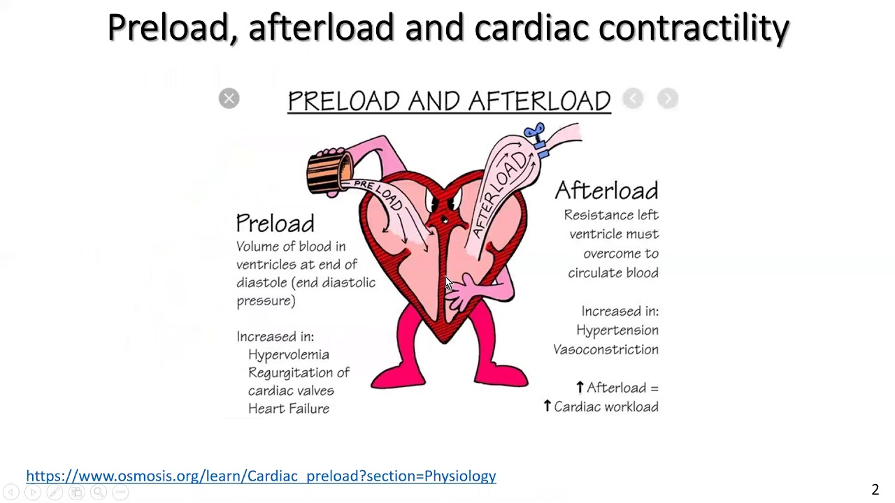
Chapt 2: Try New Parts (Improve Cardiac Function)
So, the longer handle increases stroke volume and if you pump at an adequate rate (say 70 beats / min or pump cycles per min) with the longer handle you have improved the output as opposed using to the shorter handle.
Now, you may have also purchased the larger diameter (larger circle) hose at the hardware store. This is physiologically like giving some medication (a vasodilator) which will decrease what is called "afterload". Afterload is the resistance the heart must pump against. So, decreasing the afterload (getting a larger diameter hose) decreases the work of the heart. If you pump water through a 1 inch diameter garden hose, it will be easier than trying to pump the same amount of water through a ¼ inch diameter drinking straw. So, to review, the longer handle improves the "stroke volume", which is the amount of blood the heart pumps with each beat, multiplied by the number of beats per minute (heart rate). Back to the heart, the average adult heart pumps about 5 liters of blood per minute. This is about 70 ml of blood with each beat times an average heart rate of 70 beats per minute (4900 ml or 4.9 liters/min). For Perspective a normal 10 oz cup of coffee is about 300 ml.

Slide 4
Chapter 3: Recruit Muscle
As you were thinking about working the pump up and down, you thought this is a lot of work. It is a lot of work for the heart as well. So let us now think about “muscle”. The heart is a muscle (or a pump). The heart muscle can be weakened by a variety of problems including pump problems and electrical problems. Pump problems include things like angina, a lack of blood flow and oxygen which weakens the heart muscle. You would be increasingly tired if you could not take a break to get some food and a drink. Other pump problems in the real heart (and our pump) include things like leaky (regurgitant) or tight (stenotic) valves which can impact cardiac output or affect the unidirectional flow of blood. Electrical problems can include things like cardiac arrhythmias (like afib or others in the heart) or electrical problems with a pump. So, in the real heart, drugs like digoxin, or Entresto and other measures may be used to improve contractility (how effectively the heart pumps). These drugs or other maneuvers help to recruit muscle. In our game the recruitment of muscle was calling our big friend Tony and letting him work the pump.

Slide 5
Chapter 4: Order Pizza & Beer
The Pizza and Beer can be equated to the Digoxin (and other medications like diuretics - HCTZ) which improve the heart muscle’s ability to pump. So, if we consider our friend Tony to be the muscle, the pizza and beer is like the Digoxin and HCTZ which further aids him to pump more efficiently (the Digoxin allows him to have “increased strength”) while the HCTZ is like you grabbing the bucket to get rid of additional water while he works on the pump. This is the recruitment of and improvement in cardiac muscle function in the medical world. Physiologically the heart follows what is called the Starling curve and it helps to explain some of the treatments which are similar in many ways to the things you are doing to get the water out of the basement. The heart is in a unique situation since the heart literally has to pump all the blood in the system (or the blood that is returned to it through the cardiovascular system).

Slide 6
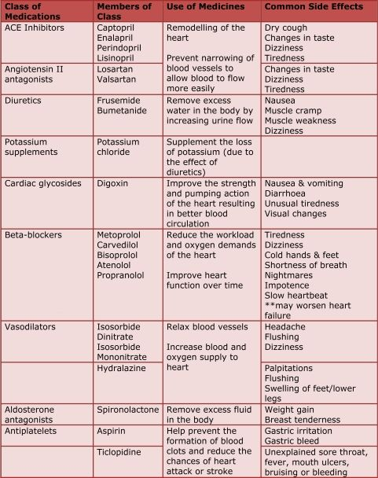
Chapter 5: The Second Flood
So, the basement is full of water. We have talked about some of the things you can do to improve your ability to get the water out of the basement. And your logical thinking about pumping water out of the basement is being translated to similar things you can do to treat heart failure. So, now let’s look at our pump a bit more. You may have noticed some leaking around one of the valves in the pump and perhaps you are thinking about a larger diameter hose from the pump to the window. In the medical world, leaking (regurgitant) or narrowed (stenotic) heart valves can be a part of, or be the primary cause of heart failure. In addition, if you noticed an improvement in your ability to pump the water out of the basement with the larger diameter hose, this is similar to reducing “afterload” which is the resistance the heart must pump against. It is shown in the picture on the last slide. The table shows some of the drugs used to treat heart failure. Not all drugs are appropriate for all patients, so your cardiologist may not want to offer certain medications to you as they may be harmful to your heart or interact badly with other medications you may be taking for other medical problems.

Slide 7
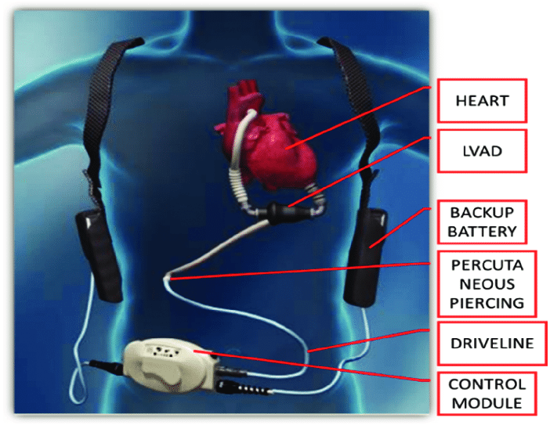
Chapter 6: Fixing the Bilge Pump
Now, as we are fighting to get the water out of the basement, we have made a number of adjustments (or repairs) to our bilge pump to improve the efficiency. The “longer handle” is to increase Stroke Volume which is the amount of blood pumped with each heartbeat (Cardiac Output = Stroke Volume x Heart Rate). We have recruited more muscle (our Friend Tony) and we have corrected valve problems in our pump (fixed the leak), and used a larger diameter hose (reduced the afterload). In the medical world, weakening of the heart muscle can be due to things like heart attacks (Myocardial Infarction, angina, primary muscle problems, or abnormal heart rhythms). The things you did to help your bilge pump are all similar to the things your cardiologist would be doing to improve your real heart’s function if you had heart failure. But it is not enough, so you get on the phone and you now order up an electric pump. This will certainly help get the water out of the basement. Medically, in a similar fashion, your cardiologist might recommend to you to consider a device called an LVAD (Left Ventricular Assist Device) which is literally an electric pump to help your heart’s function. Medically, this is for someone with severe heart failure.

Slide 8
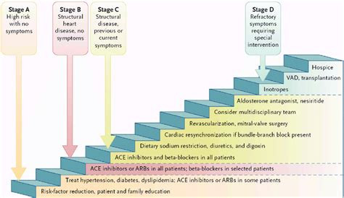
Chapter 7: “Transplanting” to a New House
An LVAD (Left Ventricular Assist Device) is an electric pump. Just like the natural heart, we need to have it functioning properly and efficiently. It is sometimes referred to as a “bridge to transplantation”. In our game, the transplantation would be equivalent to buying a new house. You may have seen the “For Sale” sign on that house on the top of the hill in your trips to the Hardware Store. A Heart Transplant would be the final treatment for Heart Failure. This is a major procedure and is not often available as the are many people waiting for a heart in order to have the procedure performed. As you see in the graph, if a transplant is not available, the patient then will need hospice (end of life) care.

Slide 9
Chapter 8:
The electric pump which you used to pump out the basement is similar to a device called an LVAD (Left Ventricular Assist Device) which is used to treat heart failure. It is sometimes referred to as a “Bridge to Transplantation”. Heart transplants, while more common now are major surgical procedures with many challenges to overcome after surgery, including the body’s immune system rejecting the transplanted heart. In our game, the concept of a heart transplant was represented by our character’s option to buy a new house (on the top of the hill).

Slide 10
Chapter 9: End of Game
Congratulations! Working through our Flooded Basement game, we hope to have provided you with some of the thought processes drugs and therapies used in the treatment of heart failure. Some of the “common sense” you applied to pumping the water from the basement are similar to principles in treatment of heart failure. Some of these include:
Increasing Stroke Volume (larger pump handle) to Increase Cardiac Output (Stroke Volume x Heart Rate). Afterload reduction (the larger diameter hose from the pump to the window). Recruit more heart muscle to pump more effectively (Calling your friend Tony and feeding him so he would keep pumping effectively). The electric pump equates to the Left Ventricular Assist Device and the buying a New House represents cardiac transplant. Other things cardiologist may consider include treating valvular abnormalities and rhythm problems which if correctable may also help to improve cardiac function. In addition there are some other medications which can help which include diuretics (increase urination) and nitrates (to improve blood flow to the heart muscle to improve contractility and cardiac output. Newer Medications you may take include ACE inhibitors and ARBs.

